Slide 1

Capital Asset Cost Management
Asset management has defined three cost categories: Contract, Operations, and Maintenance.
Each cost is further classified into three cost elements (Material, Labor, or Equipment):
Material - Costs from material transactions.
Labor - Costs from labor resource transactions.
Equipment - Costs from equipment resource transactions.

Slide 2
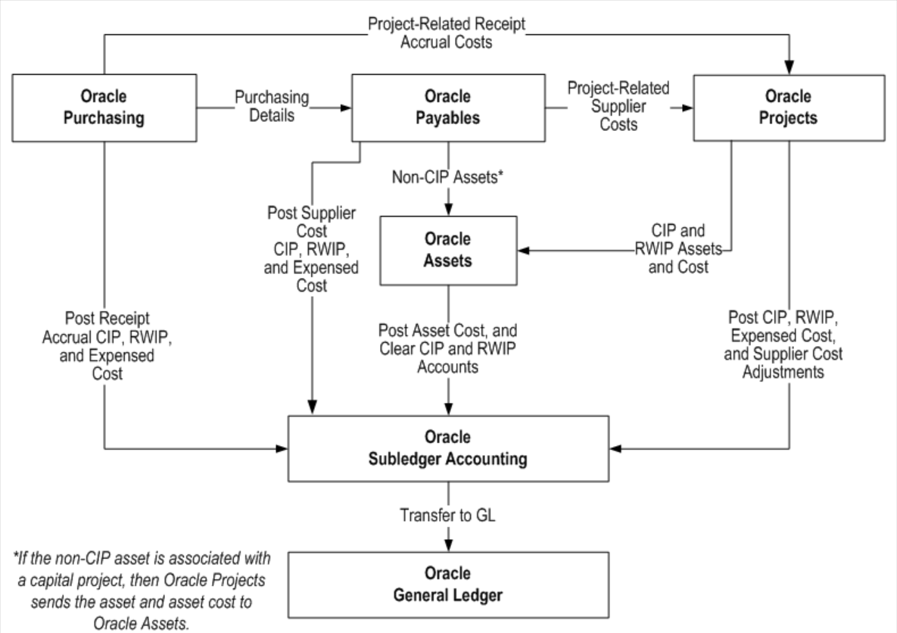
Below is a diagram of the “Capital Projects Processing Flow,” which illustrates the system's information flow from purchasing (AP), asset creation, costing project, and adjustments (if costs are incorrectly attributed) through to the General Ledger (GL):

Slide 3
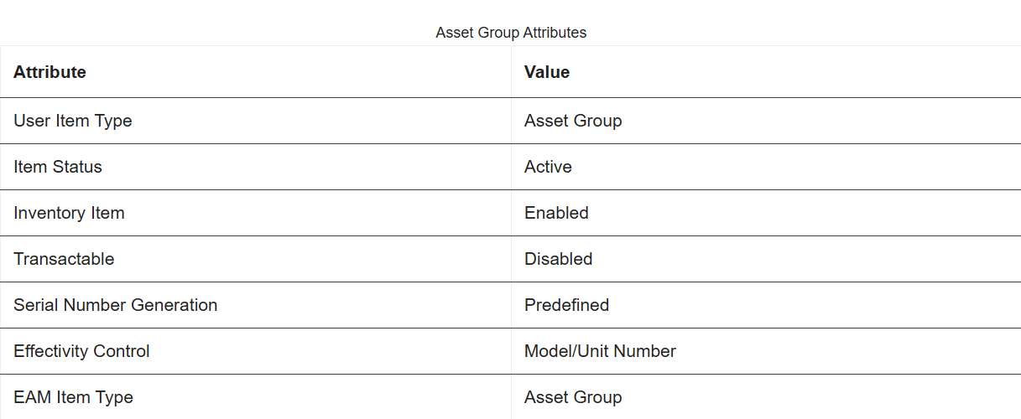
Using Capital Projects to Create Capital Assets:
For capital assets, specify how to capitalize the long-term expense on each transaction charged to a capital project. Define and build capital assets in capital projects using information specified in the project work breakdown structure. By defining asset grouping levels and assign assets to the grouping levels to summarize the CIP costs for capitalization. Review capital project costs before and adjust after capitalization in case of an update in accounting systems.
To define a CIP retirement adjustment asset for a capital project, enter asset information, such as the asset name, asset number, book value, asset category, and date placed in service or date retired.
Capture retirement costs in a capital project by recording cost of removal or retiring.
To associate retirement costs with a group asset in Oracle Assets, create a retirement adjustment asset in the capital project and identify it with a specific group asset.

Slide 4
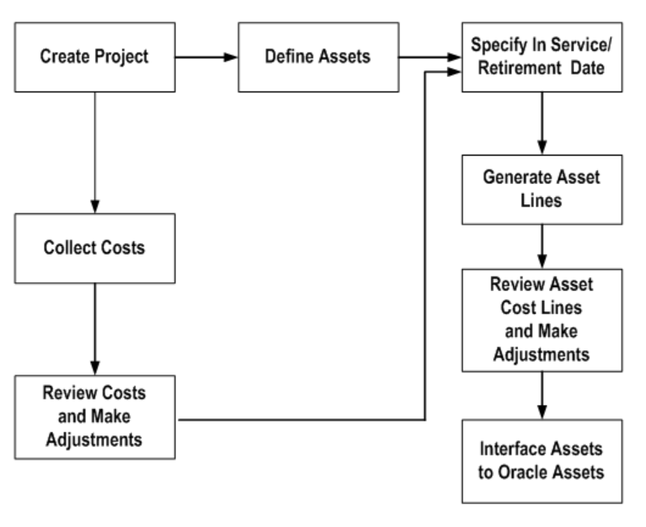
Cost allocation to navigate the capital project window to capitalize CIP asset costs:
Find the capital project in which assets place in public service by entering search criteria, such as estimated in service date, project name or number, project type, department code.
Costs are distributed based on the grouped CIP cost for each asset.
The actual date of service or retirement date must fall in the current or a prior Oracle Assets accounting period.
A capital asset or retirement adjustment asset must be associated with the asset line.
Capital Project Workflow:

Slide 5
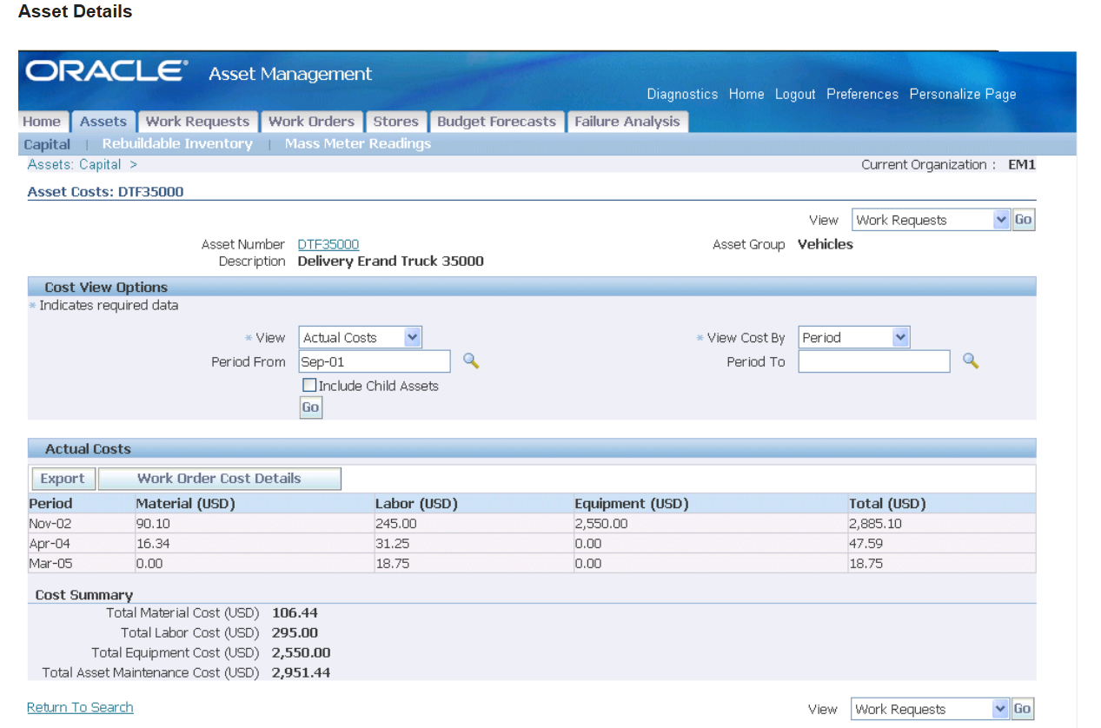
The screenshot below of Oracle’s asset service and management module is from an older version, as referenced on https://www.oracle.com/university/. However, the functions and applications are configured the same within the current insight systems.
Track asset costs in asset management window:

Slide 6
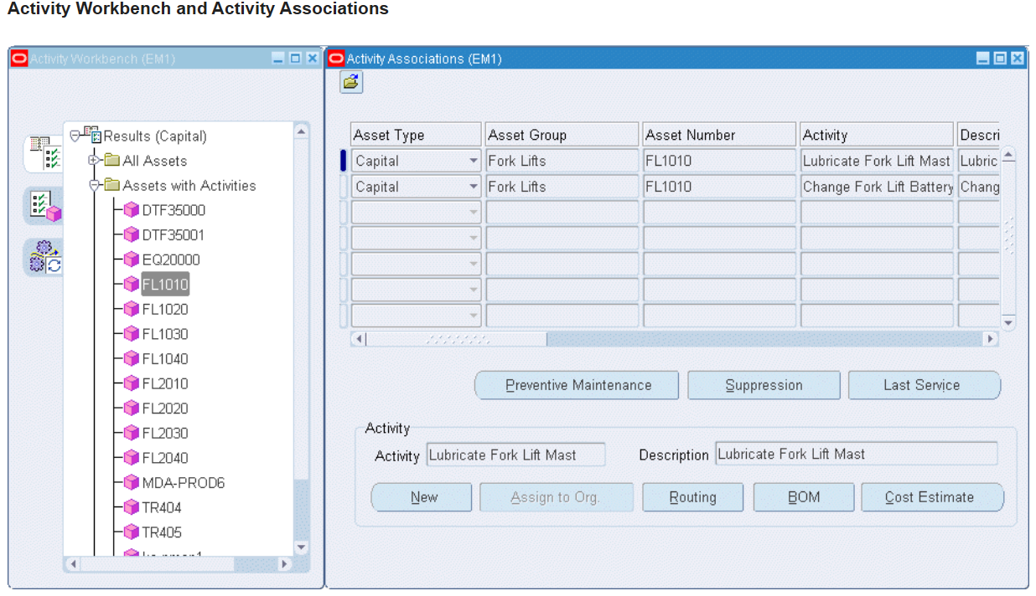
Create a view of a single asset or asset group and its associated activities by connecting SQL and PeopleSoft to analytical application.

Slide 7
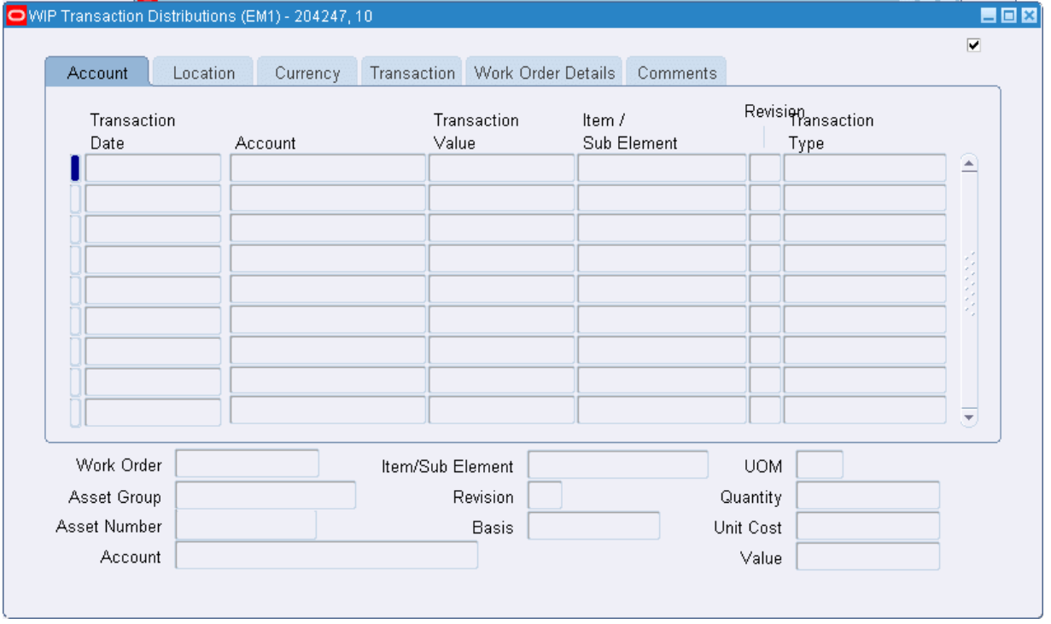
Select the distributions window to view the specific “Account” or “Location” charged to an individual construction project.
WIP Transaction Distributions:

Slide 8
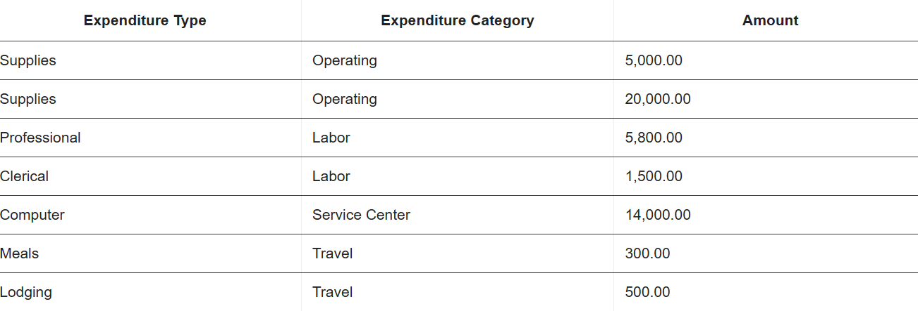
Reviewing and Adjusting Capital Project Costs:
Description of how to adjust asset lines created by the Generate Asset Lines process.
Adjust assets after they have been interfaced to Oracle Assets process these cost allocation and adjustments in Oracle Projects and send them to Oracle Assets as adjusting asset lines.
An Example of Mapping Costs to Assets:
Assume that assigning one asset to a capital project at the project grouping level.
As shown in the following table, charge the following expenditure items to the project, all of which are capitalizable and charged to the same CIP account.

Slide 9
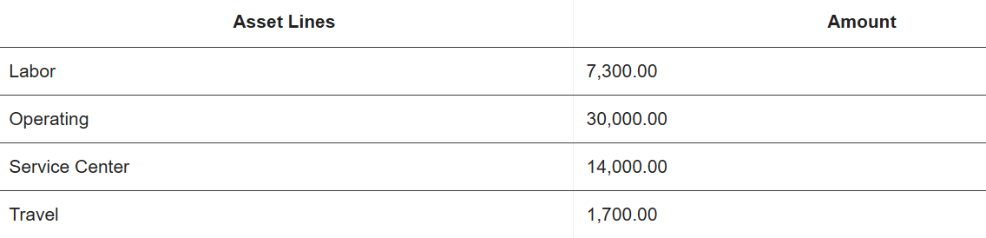
A grouping method of Expenditure Category, Oracle Projects creates the asset lines shown in the following table:
Explanations: The above information and visuals just refer to the previous version of Oracle’s Capital Asset Costing Project section. Based on my previous experience in the Seattle City Light Department, there are differences displayed in the “Enable Account,” “Define Asset to Cost Allocation,” and “Asset Line Generation.” I can use the “Inquiry Feature” to retrieve the system’s historical data for existing projects to review or adjust costs if necessary. Additionally, implementing code to fetch data from the investigated asset account and number and their associated transaction records.

Slide 10

Summary and Conclusion
This asset cost management project process involves identifying and creating an asset, allocating cost to the appropriate project, and reviewing a scope of relevant information from system for diagnosis and analysis, for which will based on the departmental cost allocation rules. An illustration of ten-slide procedure ensures accuracy and compliance, supporting effective asset management.
Diagram and informational guide provide throughout the long-term project work process play a critical role in enhancing well-understanding instruction. They offer clear insights into managing CIP tangible asset cost review and adjusting costing project from start to finish, making a complex workflow easy to navigate all relevant information.
Implementing this process promotes operational efficiency in monitoring costing project activities and enables continuous improvement to address potential challenges, such as data hidden information gap caused by ERP system restriction on viewing target information. I suggest writing code to query from the factual data sources within Oracle database. Overall, this approach supports a well-informed, efficient method for all asset transaction analyses and managements.

